Slide 1
USB Security In Cyber Security

Slide 2
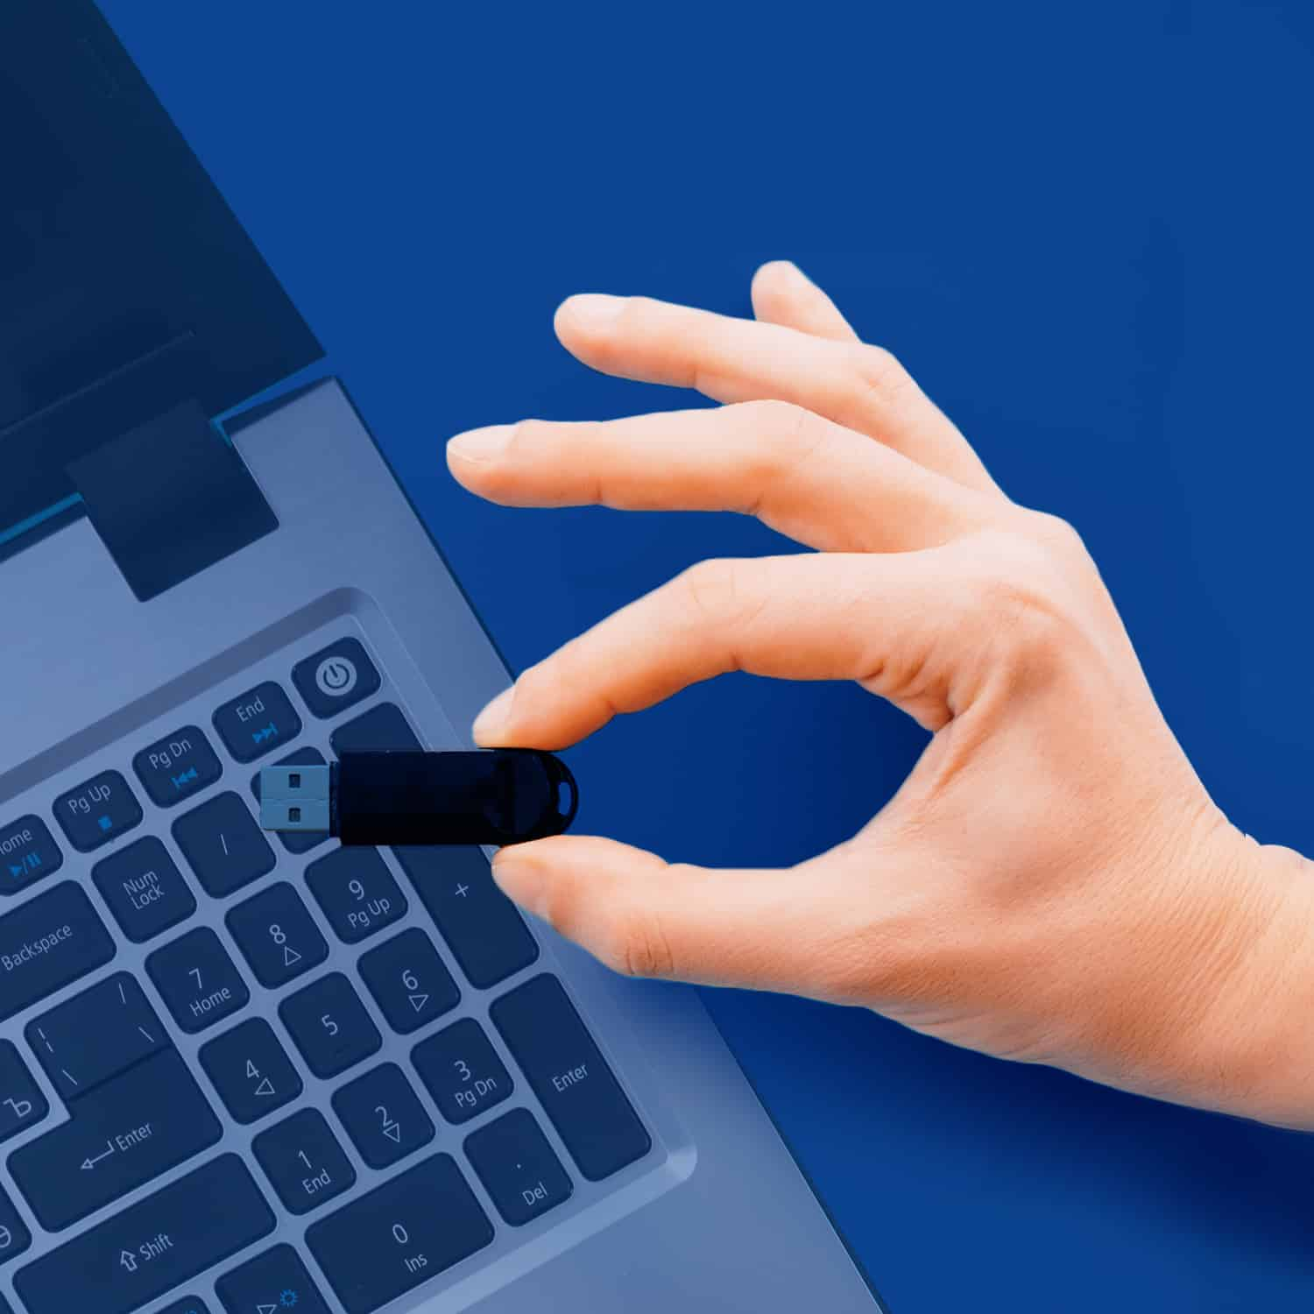
Introduction to USB Security
USB drives are commonly used for data transfer and storage, making them a frequent target for cyber threats.
Due to their portability, they can easily be lost or stolen, leading to potential data breaches.
Understanding USB security is crucial for protecting sensitive information from unauthorized access.
1
Notes:
Image source: https://www.liventus.com/usb-drive-security-best-practices/

Slide 3
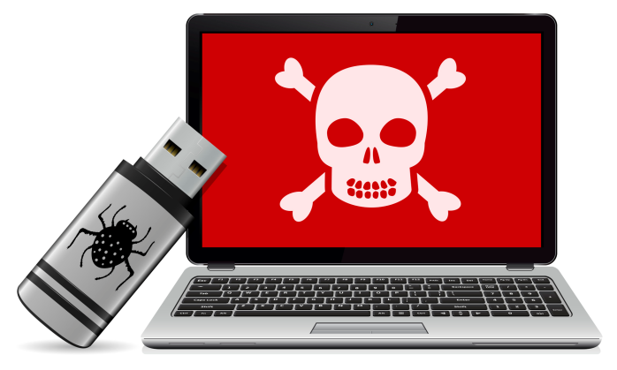
Common USB Threats
Malware can be easily introduced through infected USB devices, spreading quickly across networks.
Data theft can occur when unauthorized users access sensitive files stored on USB drives.
Physical attacks can happen when malicious individuals use rogue USB devices to exploit vulnerabilities in systems.
2
Notes:
Image source: https://www.thesslstore.com/blog/usb-flash-drive-malware-how-it-works-how-to-protect-against-it/

Slide 4
Best Practices for USB Security
Always encrypt sensitive data on USB drives to protect it in case of loss or theft.
Regularly scan USB devices for malware using up-to-date antivirus software before accessing files.
Implement policies that restrict the use of USB drives to authorized personnel only.
3
Notes:
Image source: https://www.liventus.com/usb-drive-security-best-practices/

Slide 5
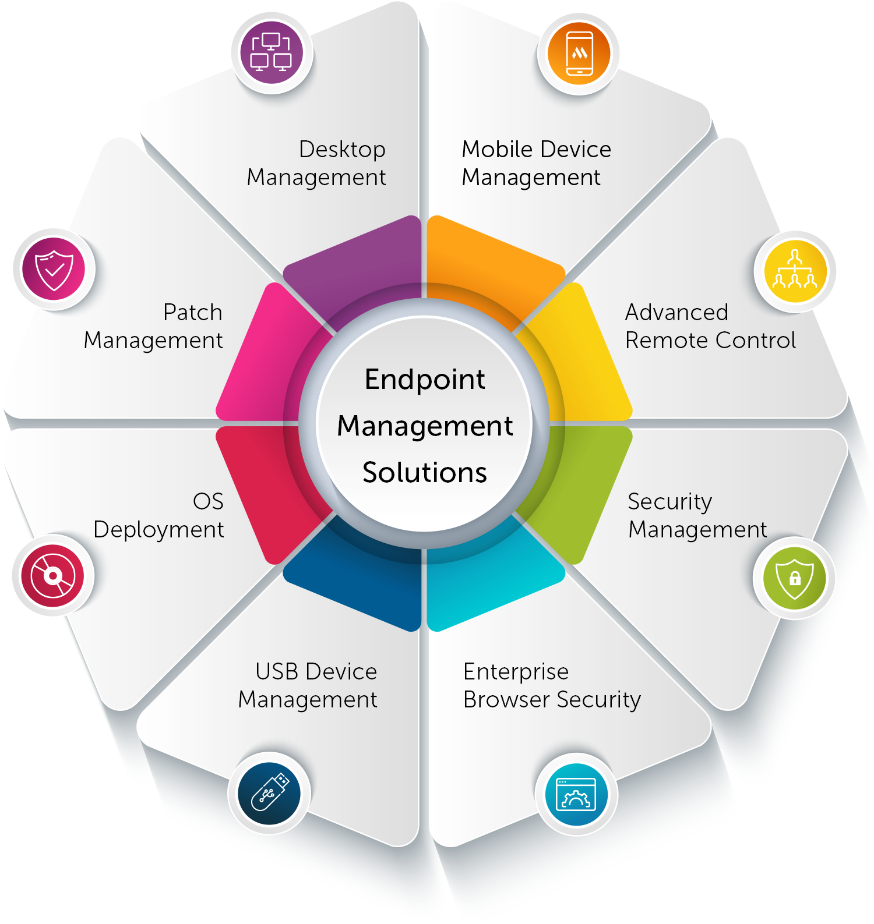
Device Management and Control
Use endpoint protection solutions to monitor and manage USB device access on organizational networks.
Employ device whitelisting to allow only approved USB devices to connect to systems.
Regularly audit USB usage and access logs to identify any unauthorized or suspicious activity.
4
Notes:
Image source: https://www.manageengine.com/products/desktop-central/endpoint-management-solutions.html

Slide 6
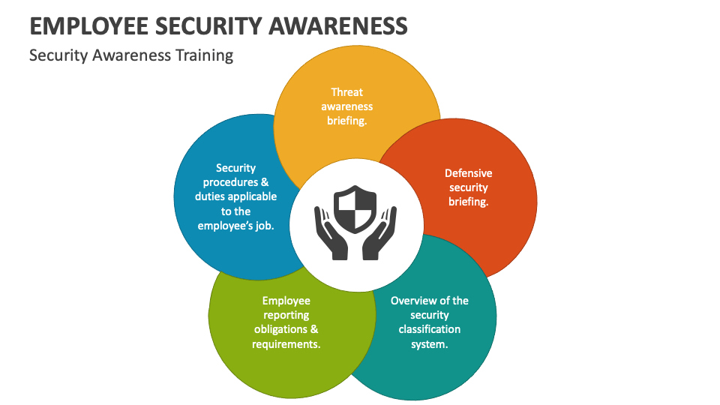
Employee Training and Awareness
Conduct regular training sessions to educate employees about the risks associated with USB devices.
Promote awareness of safe practices, such as avoiding unknown USB drives and reporting lost devices.
Encourage the use of secure alternatives, like cloud storage or secure file transfer protocols.
5
Notes:
Image source: https://www.collidu.com/presentation-employee-security-awareness

Slide 7
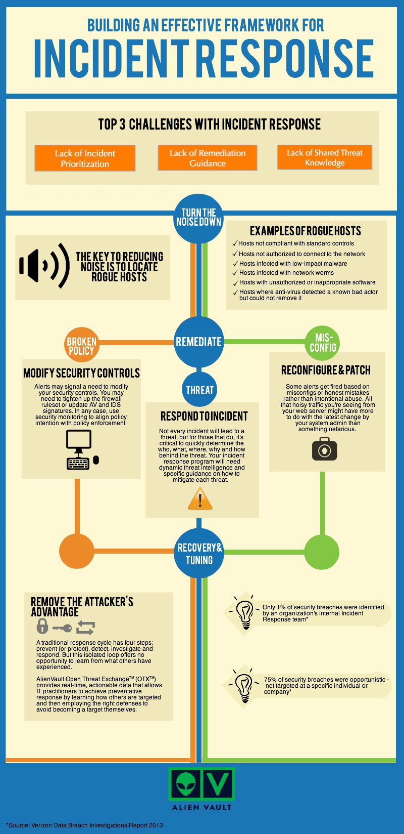
Incident Response Planning
Develop a response plan for incidents involving USB-related data breaches or malware infections.
Ensure that employees know the steps to take if they suspect a USB device has been compromised.
Regularly review and update the response plan to address new threats and vulnerabilities.
6
Notes:
Image source: https://meganward.z13.web.core.windows.net/incident-response-plan-flow-chart.html

Slide 8

Regulatory Compliance
Understand the regulatory requirements related to data protection and USB security within your industry.
Implement measures to ensure compliance with regulations like GDPR, HIPAA, or PCI DSS that may impact USB usage.
Regularly assess compliance status and make necessary adjustments to security policies and procedures.
7
Notes:
Image source: https://finreg-e.com/the-key-to-efficient-effective-regulatory-rule-mapping/

Slide 9
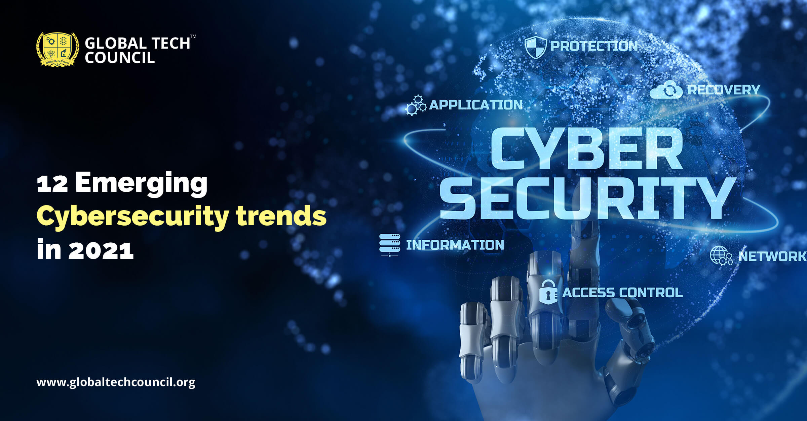
Future Trends in USB Security
Emerging technologies, such as biometric authentication, may enhance USB security in the future.
The rise of USB-C and other new standards brings both new features and potential vulnerabilities.
Continuous innovation and adaptation in USB security practices are essential to keep pace with evolving threats.
8
Notes:
Image source: https://www.globaltechcouncil.org/cyber-security/12-emerging-cyber-security-trends-in-2021/

Slide 10
THANK YOU
9

